Slide 1
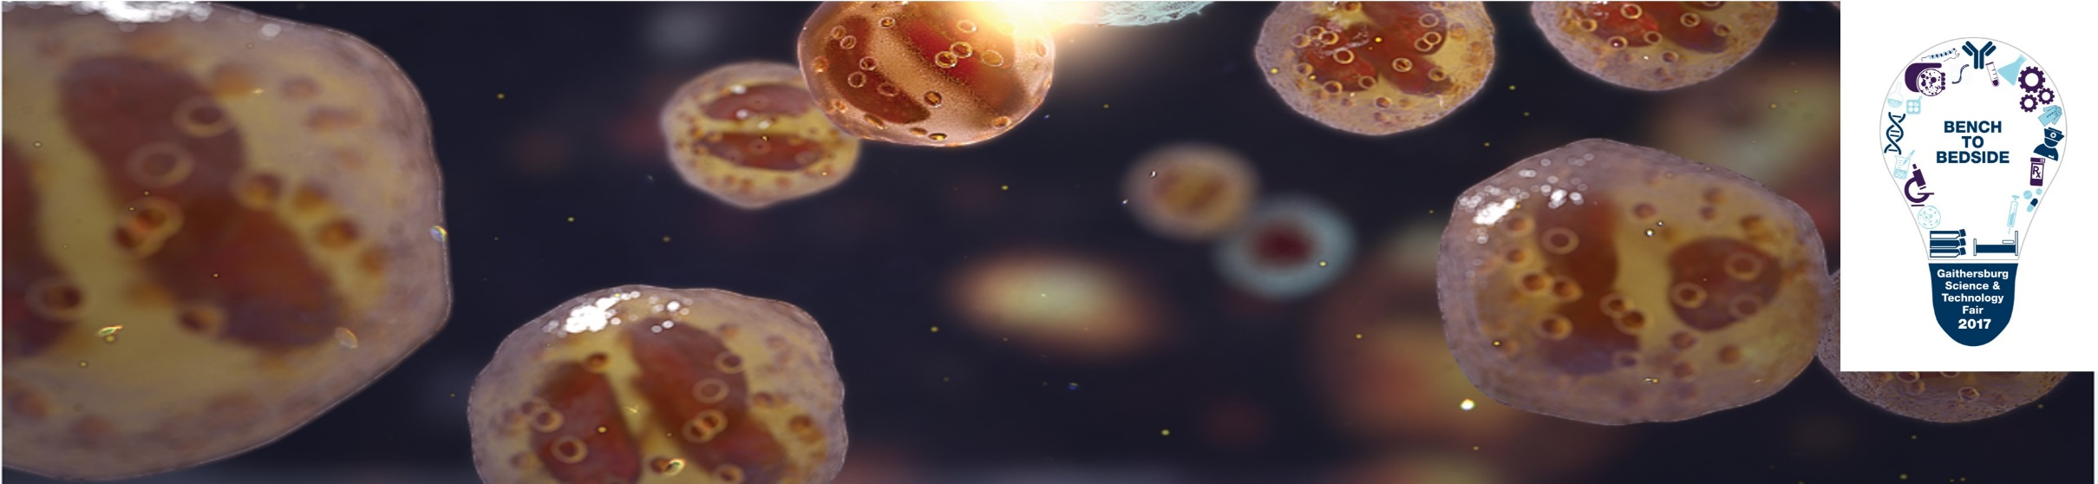

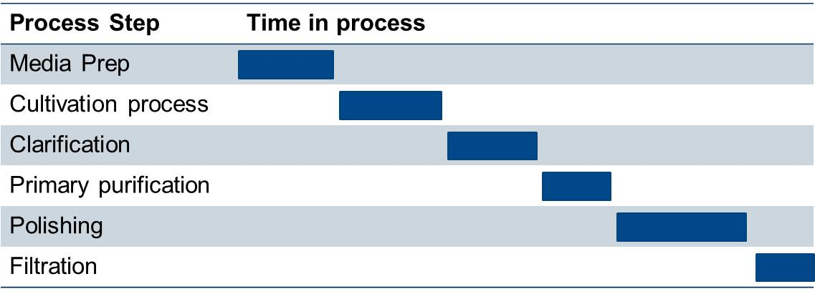
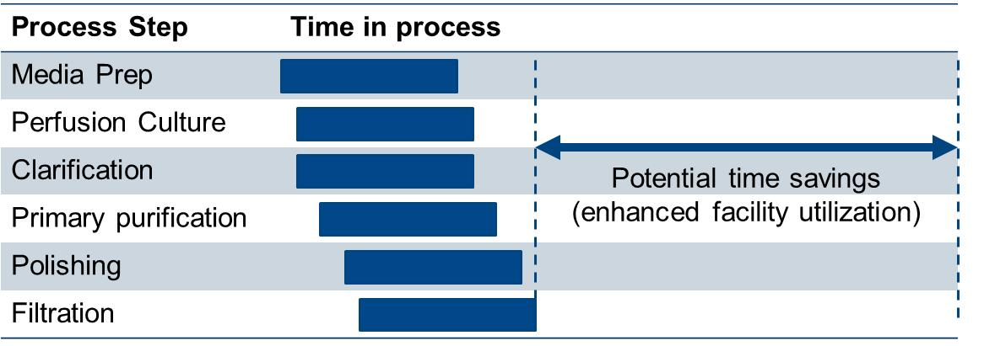




Development of an Integrated, Continuous Manufacturing Process for Monoclonal Antibodies
Lindsay Arnold¹, Joanna Pezzini¹, Ken Lee², Jeong Lee²
Jim Dyer¹, Antonio Martinez¹
1. BioProcess Engineering, AstraZeneca, One MedImmune Way, Gaithersburg, MD 20878
2. Cell Culture and Fermentation Sciences, AstraZeneca, One MedImmune Way, Gaithersburg, MD 20878
#009
Abstract
Data and Results
With a significant increase in the number of products in our pipeline entering late phase clinical development, meeting the projected production demand has been identified as one of the key future challenges for MedImmune. In order to meet this challenge, an integrated continuous manufacturing process, from bioreactor through formulation, was developed for monoclonal antibodies. Although continuous manufacturing has been established effectively in a range of industries from petrochemical to food production, it is relatively new to the biopharmaceutical industry.
Here is described the new technology, engineering solutions, and encouraging results from a successful November demonstration of a fully integrated continuous process for MEDI4166. The work demonstrated the improved productivity, decreased equipment size, and reduced cost of goods that can be achieved with a continuous process.
Perfusion Bioreactor
Continuous upstream production was achieved with a perfusion bioreactor, pictured left. Titer was monitored over the run and is plotted below. Viable cell density averaged above 90 million cells per mL during the harvest phase.
Fresh Medium
Alternating tangential flow (ATF)
0.2 µm filter
Dead Cell Removal
Growth Phase
50 L Single-Use
Bioreactor
Introduction
Spent Medium + Product
45 L/day, 1.4 g/L
Protein A Capture
Multicolumn Chromatography
Continuous manufacturing traces its history back to the Ford assembly line, a time-honored and established method of efficient manufacturing. Benefits include enhanced productivity, quality consistency, steady state operation, and streamlined process flow, which all translate to reduced cost of goods and reduced time in plant. Continuous processing is achieved when all unit operations are operating sequentially and simultaneously, distributing a batch across the entire purification platform. Figure 1 below illustrates the potential benefits of simultaneous unit operation.
As the perfusion bioreactor continuously filtered spent medium and product, a multicolumn system was connected to continuously feed the product onto capture columns. By using significantly smaller columns with more cycles, steady state operation was achieved with dramatic resin savings
Batch
Protein A Eluate
Viral Inactivation
Continuous
To inactivate viruses, acid was added to the product stream to a low pH. A static mixer ensured mixing and was followed by a residence column. The column was sized to have a product residence time of approximately 40 minutes. The product was then neutralized in a break tank while simultaneously flowing to the next unit operation. The pH trend over time is pictured below.
Base
Figure 1. Schematic of potential time savings gained by continuous processing as compared to traditional batch processing.
Acid
However, the biopharmaceutical industry has been slow to adopt continuous processing. This work summarizes MedImmune’s first fully continuous antibody production and purification process, demonstrating feasibility of the concept as well as the potential benefits associated with continuous processing.
Product
Filter Train (AEX and VF)
Process Design
P
P
P
P
P
The product flow was then pumped in series through various filtration and polishing steps. The filters and sizes are listed to the left in Table 2. Pressures were monitored over time to ensure no limits were exceeded. CEX was omitted due to equipment constraints.
The fully continuous train design (Figure 2) demonstrates a lean platform process used to purify monoclonal antibodies. While the process description is loosely based on a platform process, equipment availability limited the full implementation of a platform process.
Table 2
(1)
(2)
(3)
(4)
(5)
 | Size | Capacity | Life Time (hr)
(1) Depth Filter | 0.027 m² | 500 L/m² | 7.7
(2) Single-Pass TFF | 3 x 88 cm² | N/A | N/A
(3) SHC Filter | 0.014 m² | 1400 L/m² | 23.5
(4) Mustang Q- AEX | 44 cm² | 5000 g/L | 4.2
(5) Planova- Viral Filter | 0.12 m² | 100 L/m² | 14.4
Formulation (UF and DF)
Bioreactor
Multicolumn
Chromatography
Viral Inactivation
Filter Train
Single-Pass Diafiltration
Continuous UF/DF was achieved by using Single Pass TFF (SPTFF) modules in series. No recirculation tank was required, and product was fed uni-directionally through the process. Diafiltration was achieved by diluting the concentrated product with dialfiltration buffer back to the feed conditions and repeated this process in 3 SPTFF modules. Final ultrafiltration was done across a fourth SPTFF.
Figure 2. Process flow of combined unit operations in the continuous process design.
This process was assembled at pilot scale, using a bioreactor with a 30 L working volume. However, the required flow rates compared to that of batch are drastically lower and are outlined below in Table 1. The mismatched mass flow rates of the unit operations indicate the downstream could handle a bioreactor 5 times the size.
Feed
(15 g/L)
Retentate
(150 g/L)
Pre-Formulated Bulk
110 g/L
1.35% Aggregate
24 ng/mg HCP
5.2E-5 ng/mg DNA
Table 1. Mass balance of the process streams, including flow rates and concentrations.
TFF
TFF
TFF
TFF
Process Stream | Flow Rate (mL/min) | Concentration (g/L) | Mass Flow Rate (g/hour)
Outlet of Brx | 31.3 | 1.4 | 2.6
Inlet to ProA | 21 | 1.4 | 1.7
Outlet of ProA | 2.3 | 12.9 | 1.7
Inlet to VI | 15 | 11 | 11.7
Outlet of VI | 22 | 8.9 | 11.7
Outlet of UF1 | 10.4 | 18 | 11.7
Inlet to DF | 13 | 16 | 11.7
Outlet of UF2 | 2 | 110 | 11.7
Permeate
Conclusion and Future Work
This work demonstrates the first successful continuous processing purification run at MedImmune. MEDI4166 was produced in a perfusion bioreactor, purified, and formulated at pilot scale using new enabling technologies and solutions facilitating continuous processing. Future work includes:
Improved automation to facilitate improved control and prolonged operation with minimal intervention
Steps toward aseptic design
Demonstrate endotoxin and bioburden control
Implement with batch harvest to compare benefits or drawbacks
Process analytical technology (PAT) to monitor process outputs in real time

